Slide 1


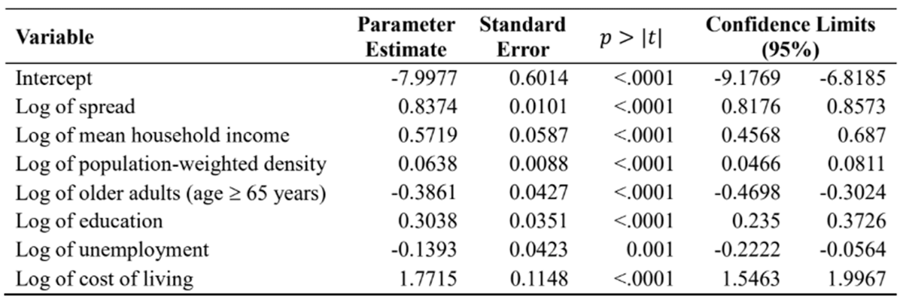
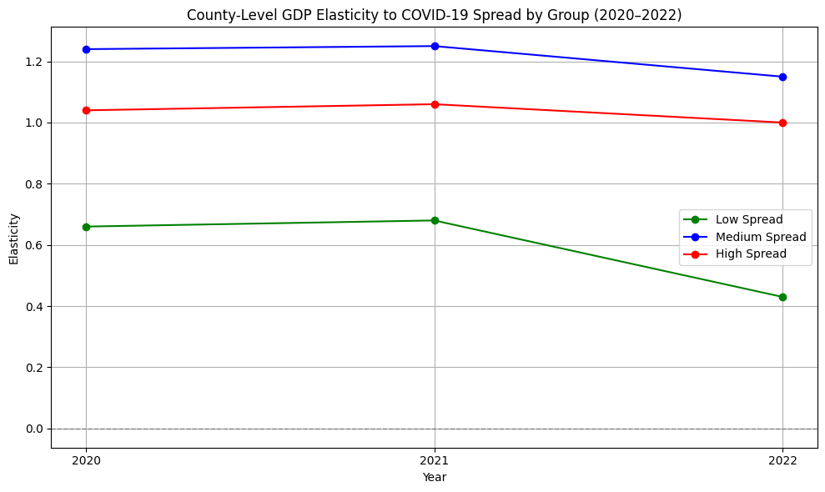
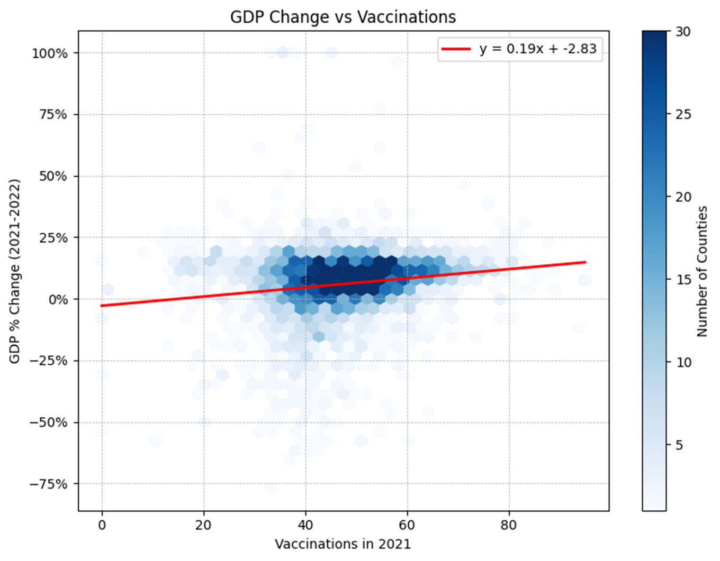
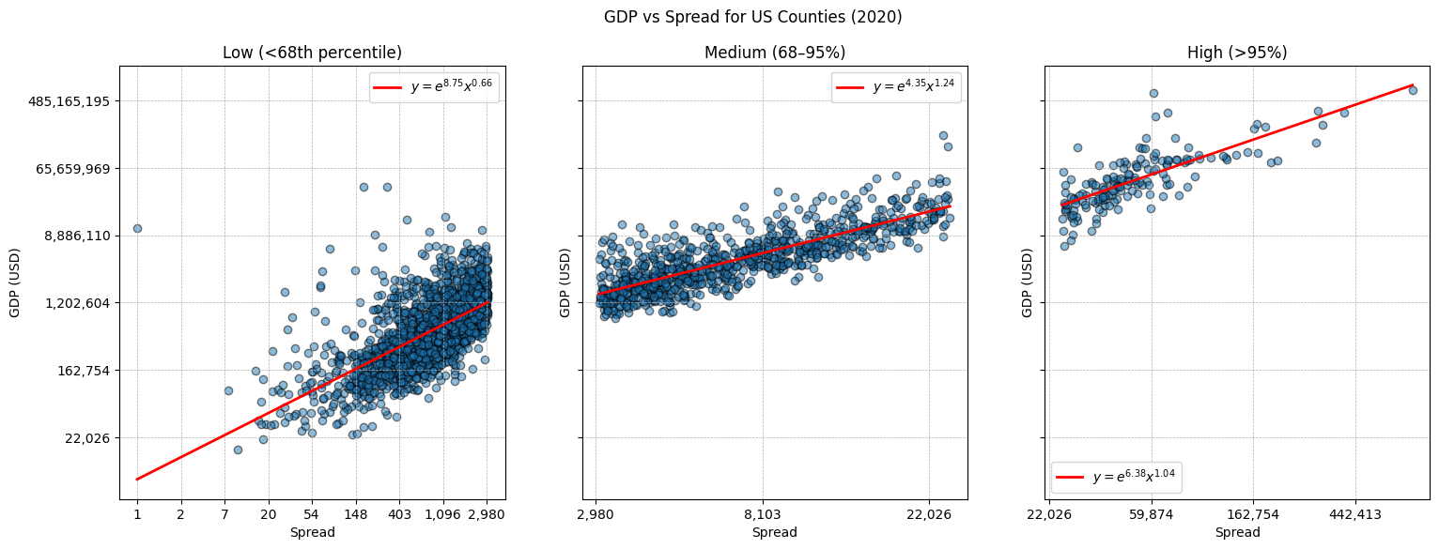
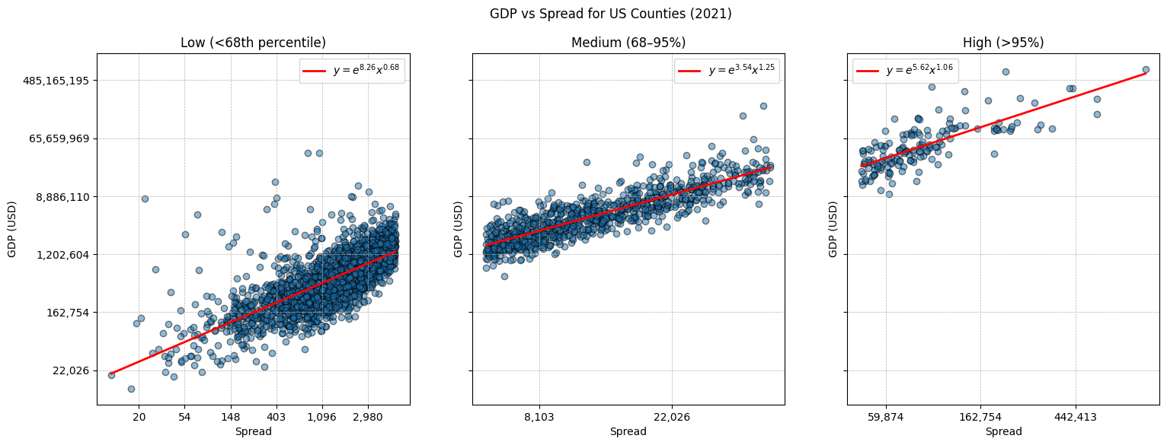
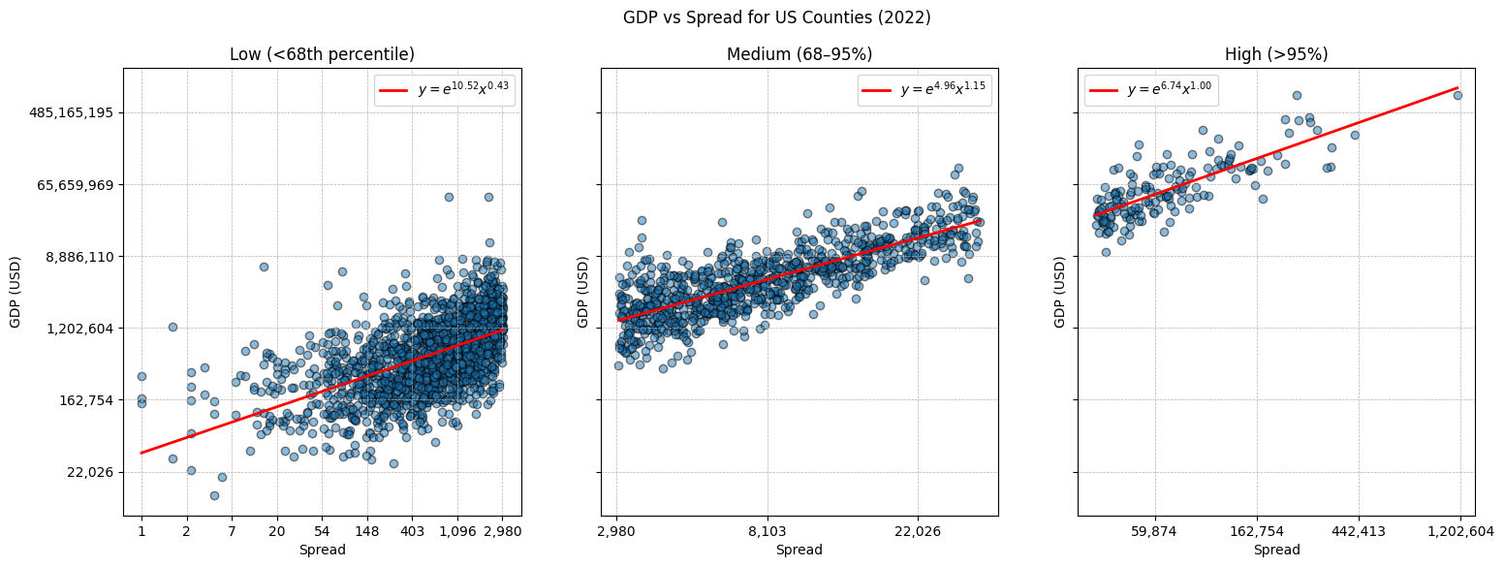
Economical Impact of COVID-19 in the US: County Level
Angelica Tellez
Advisor: Huseyin Yuce
Results
Abstract
Table 1 : Parameter Estimation of GDP Model in the US
Figure 3 : GDP Elasticity to Spread by Group (2020-2022)
COVID-19 pandemic triggered an unprecedented economic crisis. Many measures of restrictions (lockdowns, travel advisory, social distancing, etc.), aimed to contain the virus’s spread, led to extensive disruptions across industries. COVID-19’s total cost to the U.S. economy was projected to reach $14 trillion by the end of 2023 (Hlavka and Rose, 2023). This study includes a descriptive analysis of economic data along with multivariate regressions to generate various estimates. Additionally, we examine the impact of vaccination rates on economic indicators. The research explores the economic effects of COVID-19 in the U.S., supported by statistical modeling.
Figure 1 : GDP Percent Change vs Vaccination (2021)
Conclusion
Our findings highlight the importance of early intervention during pandemics to support economic stability. Early vaccination was linked to slight but meaningful GDP recovery in 2021, while economic impacts largely reflected 2020’s COVID-19 disruptions. A 10% increase in virus spread correlated with an 8.4% rise in GDP due to higher population density in economically strong areas, not because spread boosted growth. In contrast, increases in senior population and unemployment led to GDP declines. Counties with low COVID spread faced the least economic disruption and recovered faster by 2022, while medium-spread areas remained the most sensitive, showing the need for region-specific strategies in future crises.
Intro
This study builds upon the previous article titled “Use of Populated Weighted Density Index for Coronavirus Spread in the United States.” From that foundation, we posed a new question: how can the COVID-19 pandemic experience guide us in preparing for future outbreak-related economic crises? Given that outbreaks significantly impact labor-intensive sectors, disrupt supply chains, and ultimately strain national economies, we recognized the urgent need for proactive economic response strategies to mitigate future downturns.
Figure 2 : GDP vs Spread for US Counties (2020-2022)
Methods
For our economic indicator, we selected Gross Domestic Product (GDP), preferring it over alternatives like household income and unemployment rates because GDP offers a more comprehensive measure of economic activity. We employed a multivariate regression model where GDP served as the dependent variable. Our explanatory variables included COVID-19 spread, household income, weighted populated density, senior population percentage, education level, unemployment rate, and cost of living.
Bibliography
U.S. Census Bureau. U.S. Census Bureau. https://www.census.gov.
Johns Hopkins University. COVID-19 Resource Center. https://coronavirus.jhu.edu.
USA Facts. USA Facts. https://usafacts.org.
U.S. Department of Labor, Bureau of Labor Statistics. U.S. Bureau of Labor Statistics. https://www.bls.gov.
U.S. Bureau of Economic Analysis. U.S. Bureau of Economic Analysis. https://www.bea.gov.
Council for Community and Economic Research. Council for Community and Economic Research. https://www.coli.org.
Centers for Disease Control and Prevention (CDC). Vaccination Coverage and Vaccine Confidence. https://www.cdc.gov/respvaxview/about/index.html.
Yuce, et al. “Use of Population Weighted Density Index for Coronavirus Spread in the United States.” Journal of Health Economics and Outcomes Research, 2024; 11(2).
Notes:
INSTRUCTIONS: Insert text in text boxes as indicated on the template. You can modify color, background, font, font size, etc. by using PowerPoint features noted in the tabs. You can add borders around text boxes and you can add lines or other graphics where desired. To add more text boxes, you can copy an existing one and move it to the desired location. You can add any graphic by dragging it onto the slide or by copying/pasting it. Be sure that your graphic has high dots per inch. Images/graphics must be cited if not original work. Use Sans Serif fonts for Titles, labels and section headers. Use Serif fonts for text in text boxes.
CONTENT:
*Introduction, Background, and/or Abstract (a place to quickly summarize your topic and trigger your audience’s interest). Usually in narrative, paragraph format.
*Materials and Methods or Process (a place to describe your process and what led to your results). Using bullet points can be a helpful way to present information.
*Results (the place where the results of your experiment are explained). Using bullet points can be a helpful way to present information.
*Conclusions or Discussion (the place where you explain why your results are conclusive and provide the reader with a short but solid justification of your hypothesis). Usually in narrative, paragraph format.
*References or Literature Cited (This is where you make a list of the literature you have cited regarding this project. List the names of authors, publications and publishing dates.) To save space, consider noting “selected references” – those references essential to the project. Citation style must follow rules designated by discipline, e.g., MLA, APA, etc.
*Acknowledgments (this is where you acknowledge grants and research programs. Also, use this section to thank the people who helped with your project. Can sometimes include your Contact Information)
*Depending on your type of research and where you are in your project, you may have to use some variation of the above.

